Slide 1


ZOMATO RESTAURANT ANALYSIS
BY GROUP 2
Twinkle Bhatt
Harita Joshi
Prayagraj Puhan
Jagadeesh Pamanji
Mahesh Keesari

Slide 2
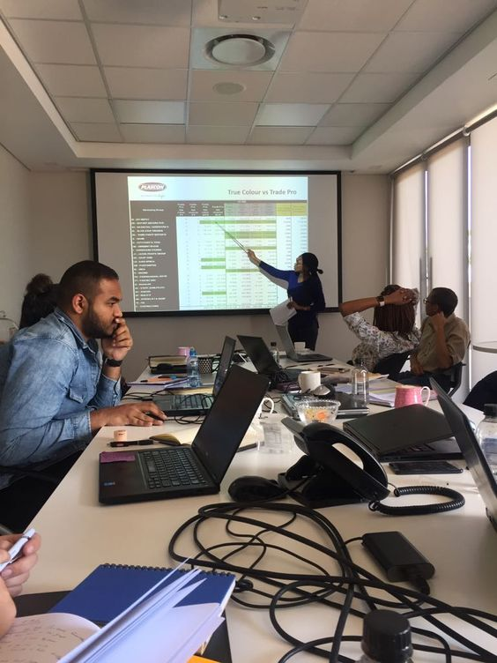
ZOMATO
Zomato is an Indian multi-national restaurant aggregator and food delivery company. It was founded by Deepinder Goyal and Pankaj Chaddah in 2008.
Zomato provides information, menus and user-reviews of restaurants as well as food delivery options from partner restaurants in more than 1,000 Indian cities and towns, as of 2022–23. Zomato rivals Swiggy in food delivery and hyperlocal space.

Slide 3

AN OVERVIEW OF DATA
9551 | 15 | 1825 | 141 | 1208
Total Restaurants | Total Countries | Total Cuisines | Total Cities | Total Localities
DATA

Slide 4


OBJECTIVES
Customer Satisfaction Analysis
Cuisine and Menu Analysis
Trends and Seasonal Analysis
Promotion and Marketing Effectiveness
Price and Value Perception
Technology Adoption
Revenue and Profitability Analysis

Slide 5

BUSINESS PROBLEMS
The business problem at hand revolves around optimizing the performance and competitiveness of restaurants listed on Zomato , a popular food delivery and restaurant discovery platform. Restaurants face challenges in maintaining high customer satisfaction levels, effectively competing with peers, and strategically positioning themselves in the market. Moreover, understanding the dynamics of customer preferences, operational efficiency, and the impact of promotional activities is crucial for sustained success.
This analysis aims to address these challenges by delving into customer reviews, ratings, and overall satisfaction metrics. It seeks to benchmark restaurant performance against competitors, identify strengths and weaknesses, and unearth opportunities for improvement. By comprehensively examining these aspects, the analysis endeavors to provide actionable insights that empower both Zomato and its affiliated restaurants to enhance their services, attract more customers, and thrive in a competitive digital marketplace.

Slide 6

BUSINESS MODEL
Value Propositions
- Data insights
Revenue Streams
- Transaction Fee
Key Activities
- Data Analysis
Actionable analytics from customer reviews and ratings.
Informed decision-making for restaurants.
Identification of strengths and areas for improvement.
Adaptation to changing consumer preferences.
Steady income through a percentage of each order.
Aligned success with partner restaurants.
Encourages active support and promotion.
Mutual benefit from increased transaction volumes.
Ongoing and rigorous customer data analysis.
Utilization of advanced analytics tools.
Informs strategic decisions for Zomato.
Provides actionable insights for partner restaurants..

Slide 7

DATA MODELLING
DATEPART, to extract information from date fields and perform date calculations.
Power BI To visualize and analyze the Zomato restaurant data, Power BI was used to create interactive dashboards. The following features and functions were utilized:
Data modeling using relationships between tables and calculated columns
Measures and DAX formulas to perform calculations on the data
Visualizations such as tables, charts, and maps to display the data Slicers and filters to enable dynamic filtering of the data Drill-through functionality to navigate between different levels of detail in the data.
Tableau In addition to Power Bl, Tableau was also used to create interactive dash boards for the
Zomato restaurant data analysis project.
The following features and functions were utilized:
Data blending to combine data from different tables.
Calculated fields to perform calculations on the data.
Dimensions and measures to organize and analyze the data.
Visualizations such as maps, charts, and tables to display the data.
Filters and parameters to enable dynamic filtering of the data.
7

Slide 8

TRANSFORMATION CHALLENGES
1. Dealing with Lots of Different Data:
- Handling a ton of different information from various sources like reviews and transactions. Needed
powerful tools to manage and organize all this data.
2. Making Sure Data Is Correct:
- Ensuring the information is accurate and consistent was tough. Some data was incomplete or not
perfectly reliable, so we had to clean it up and check it carefully.
3. Getting Info Quickly:
- Needing to provide fast insights and respond quickly to changes in the market meant we had to figure
out how to process information in real-time, instead of waiting for long periods.
4. Protecting People's Information:
- Keeping private information safe was a challenge. We had to make sure we followed rules about data
protection while still using the data effectively.
5. Putting Together Different Kinds of Data:
- Combining data from different places, like market trends and competitor info, was a bit tricky. We had
to make sure everything worked together smoothly to get a complete picture.

Slide 9

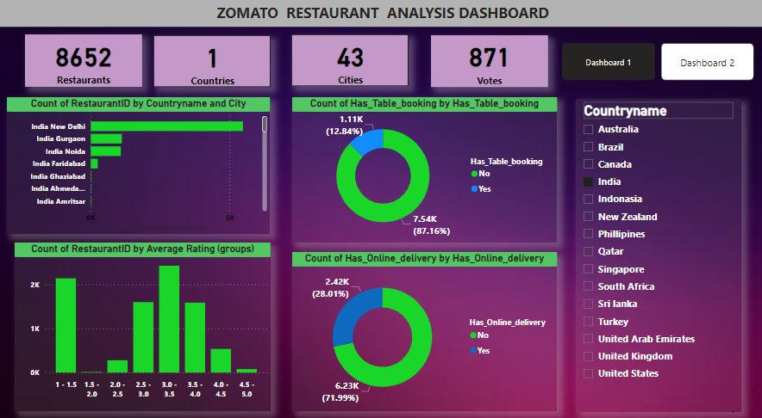
DASHBOARD

Slide 10
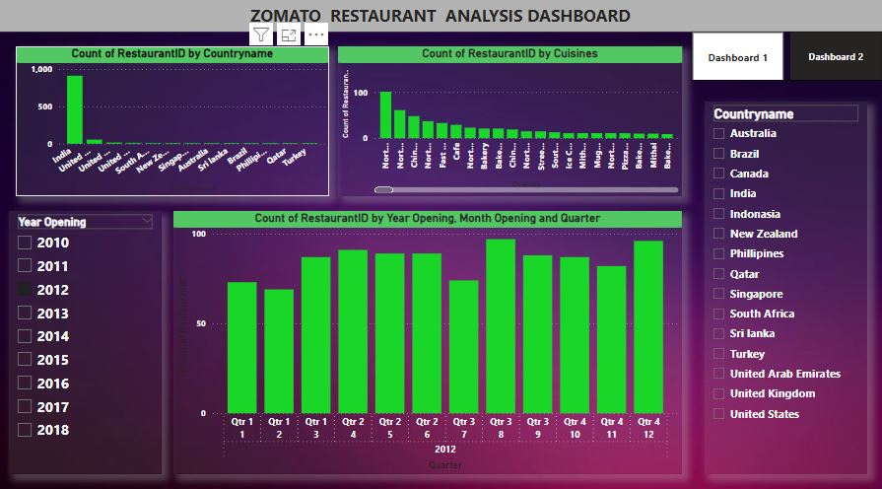
DASHBOARD

Slide 11
CONCLUSION
In conclusion, navigating the transformation of data for optimizing restaurant performance on Zomato presented multifaceted challenges, including managing diverse data sources, ensuring accuracy, adapting to real-time processing demands, addressing privacy concerns, and integrating various data types. Overcoming these challenges required a comprehensive and innovative approach, emphasizing the importance of robust data practices, technology adaptation, and a commitment to user privacy. Ultimately, successful data transformation has been pivotal in deriving valuable insights and driving the effectiveness of the overall strategy to enhance restaurant performance on the Zomato platform.

Slide 12
SUGESSTIONS
1. Personalized Experience
- Utilize advanced algorithms to offer personalized restaurant recommendations based on user preferences.
2. Optimized Pricing Strategies
- Explore dynamic pricing models to maximize revenue for restaurants and attract users with strategic pricing.
3. Operational Excellence
- Collaborate with restaurants to enhance operational efficiency, ensuring faster and more reliable service for customers.
4. Strategic Promotions
- Design targeted promotions aligned with seasonal trends and emerging food preferences to attract and retain users.
5. Community Engagement and Expansion
- Foster community engagement through features like forums and challenges, while expanding into underserved areas for a broader restaurant selection.

Slide 13
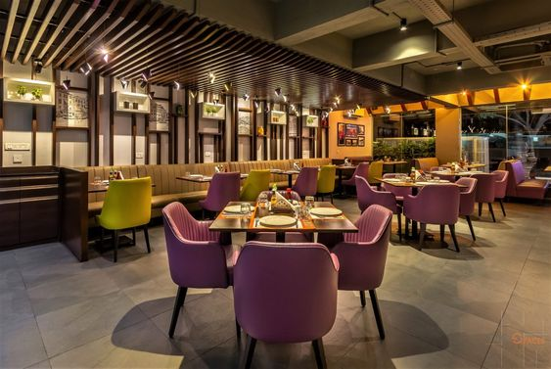

THANK YOU!
Presented by Group 2

